Slide 1
Sketching with Hardware
02: Current, Voltage, Resistance

Slide 2
What do you already know about electricity?

Slide 3
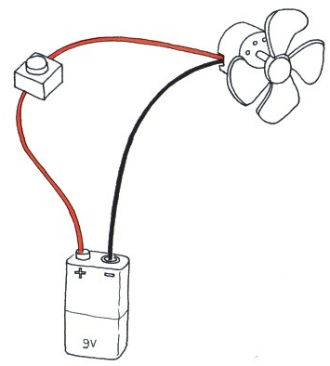
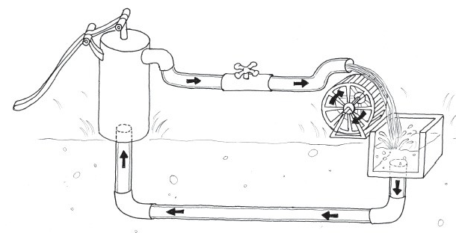
Analogy: Water circuit
Voltage (in Volt, V): ~ Water Pressure
Current (in Ampere, A): ~ Water Amount
Resistance (in Ohm, Ω): ~ Bottleneck in a Tube
Image credits © Elisa Canducci

Slide 4
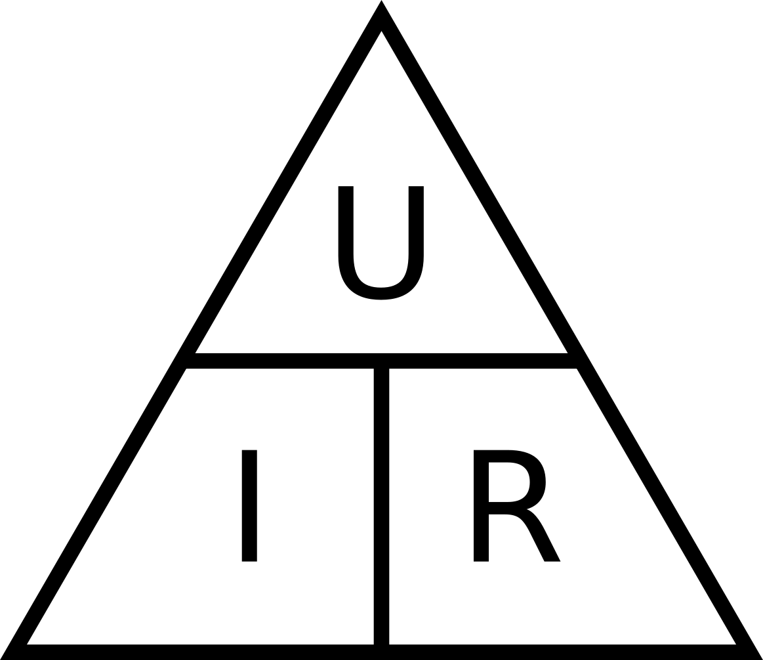
Ohm’s Law
Relationship between:
Current (I), Voltage (U) and Resistance (R)
Higher voltage results in more current
Higher resistance results in less current
R = U / I
U = R * I
I = U / R

Slide 5
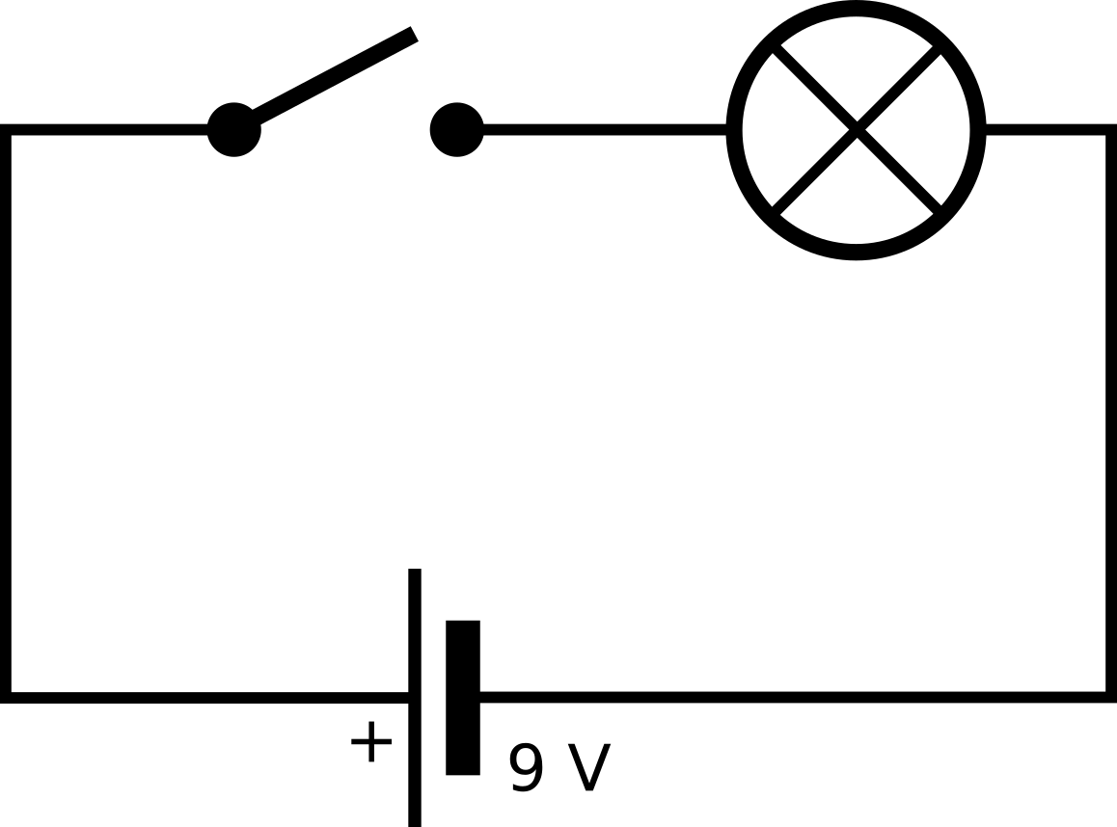
Circuit Diagrams
Formal representation of a circuit
Independent from actual components, cables, etc
Image credits © Elisa Canducci

Slide 6
Safety Instructions: Electronics
Voltages below 20 V are generally harmless (e.g. USB: 5 V)
BUT: Mains voltage (~ 220 V, AC) can be deadly!
→ no experiments with AC power
→ work exclusively with 5 V from the USB port
Fuses prevent fires but do not protect against injuries
Components can be damaged by too high voltages
→ follow the data sheet!

Slide 7
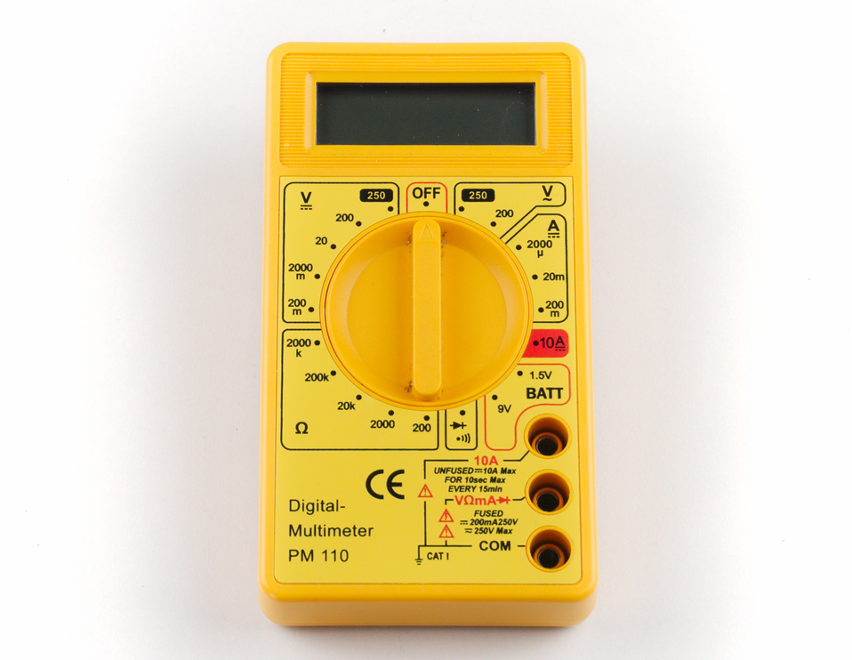
The Multimeter
Voltage
Current
Resistance
Continuity
Red Cable
Black Cable

Slide 8
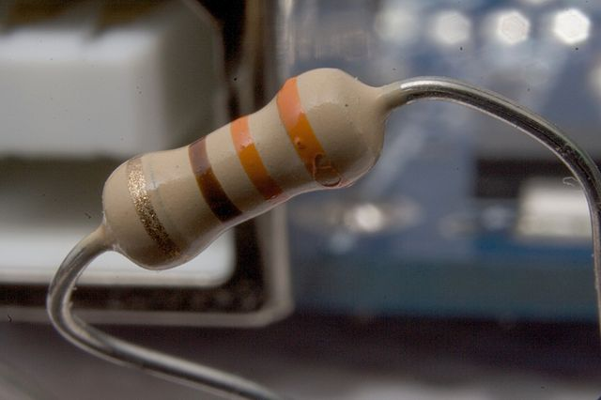
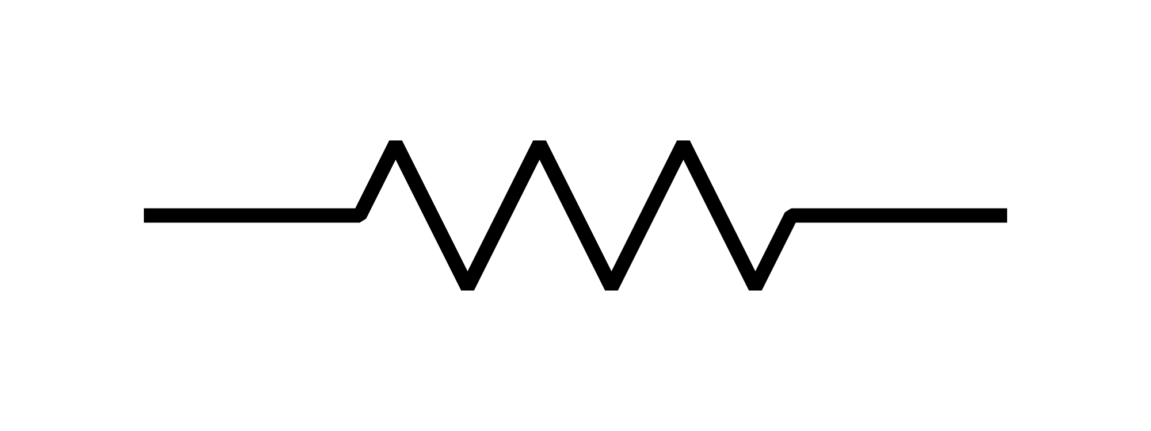
Resistors
Resistance (in Ohm, Ω)
Water circuit analogy: Bottleneck
Can be measured with the multimeter
Color code represents resistance

Slide 9
Continuity Test
Acoustic signal if a circuit is closed
Quick test of connections
Beep: Resistance is below ~ 10 Ω
Can be used to check if there are short circuits

Slide 10
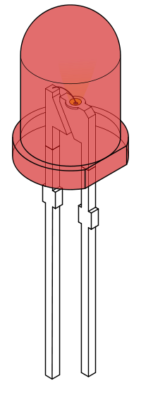
Light Emitting Diode (LED)
“Valve” for current
Current can only flow in one direction
Typical current: 20 mA
typical voltage: 2 – 4 V
Slightly too high voltage can destroy LEDs
→ dropping resistor is needed
-
+
+
-
https://commons.wikimedia.org/wiki/File:LED,_5mm,_red_%28unlabelled,_full%29.svg

Slide 11
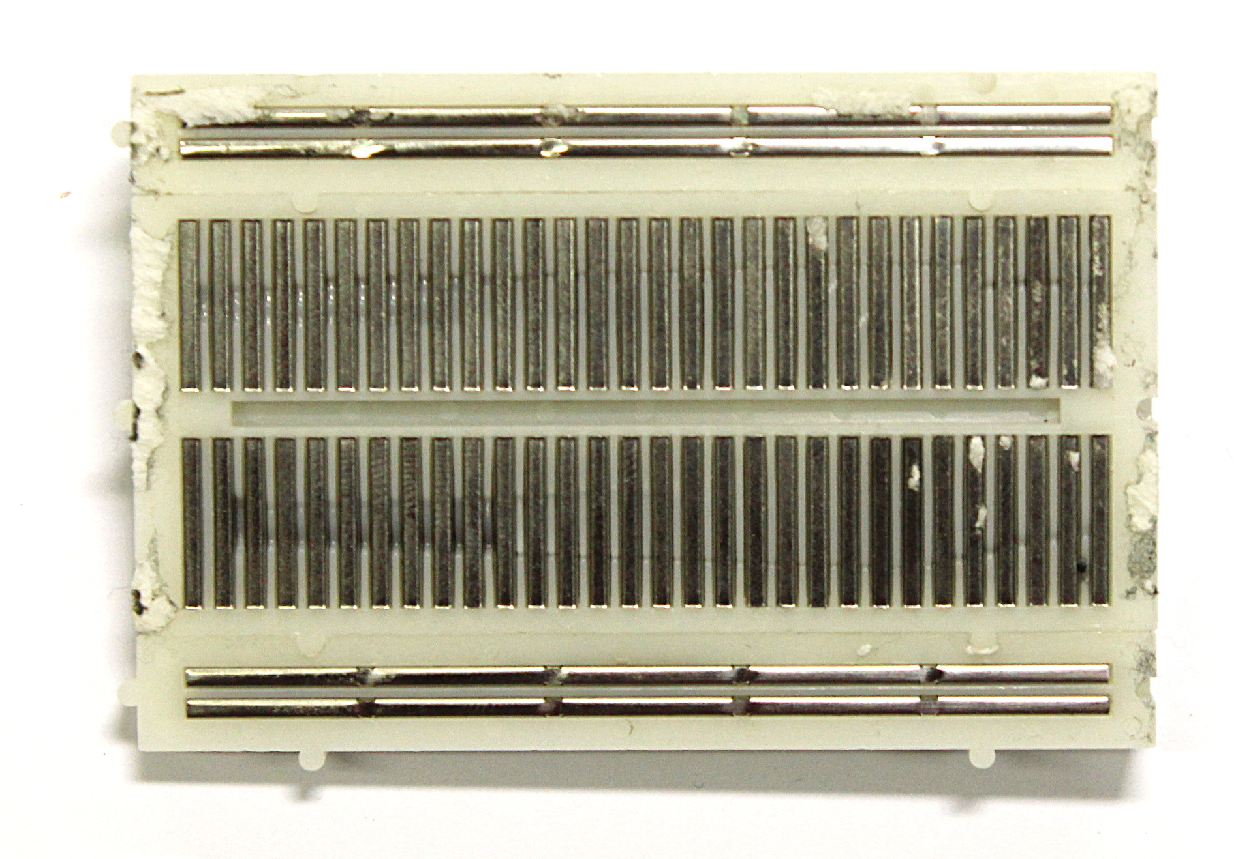
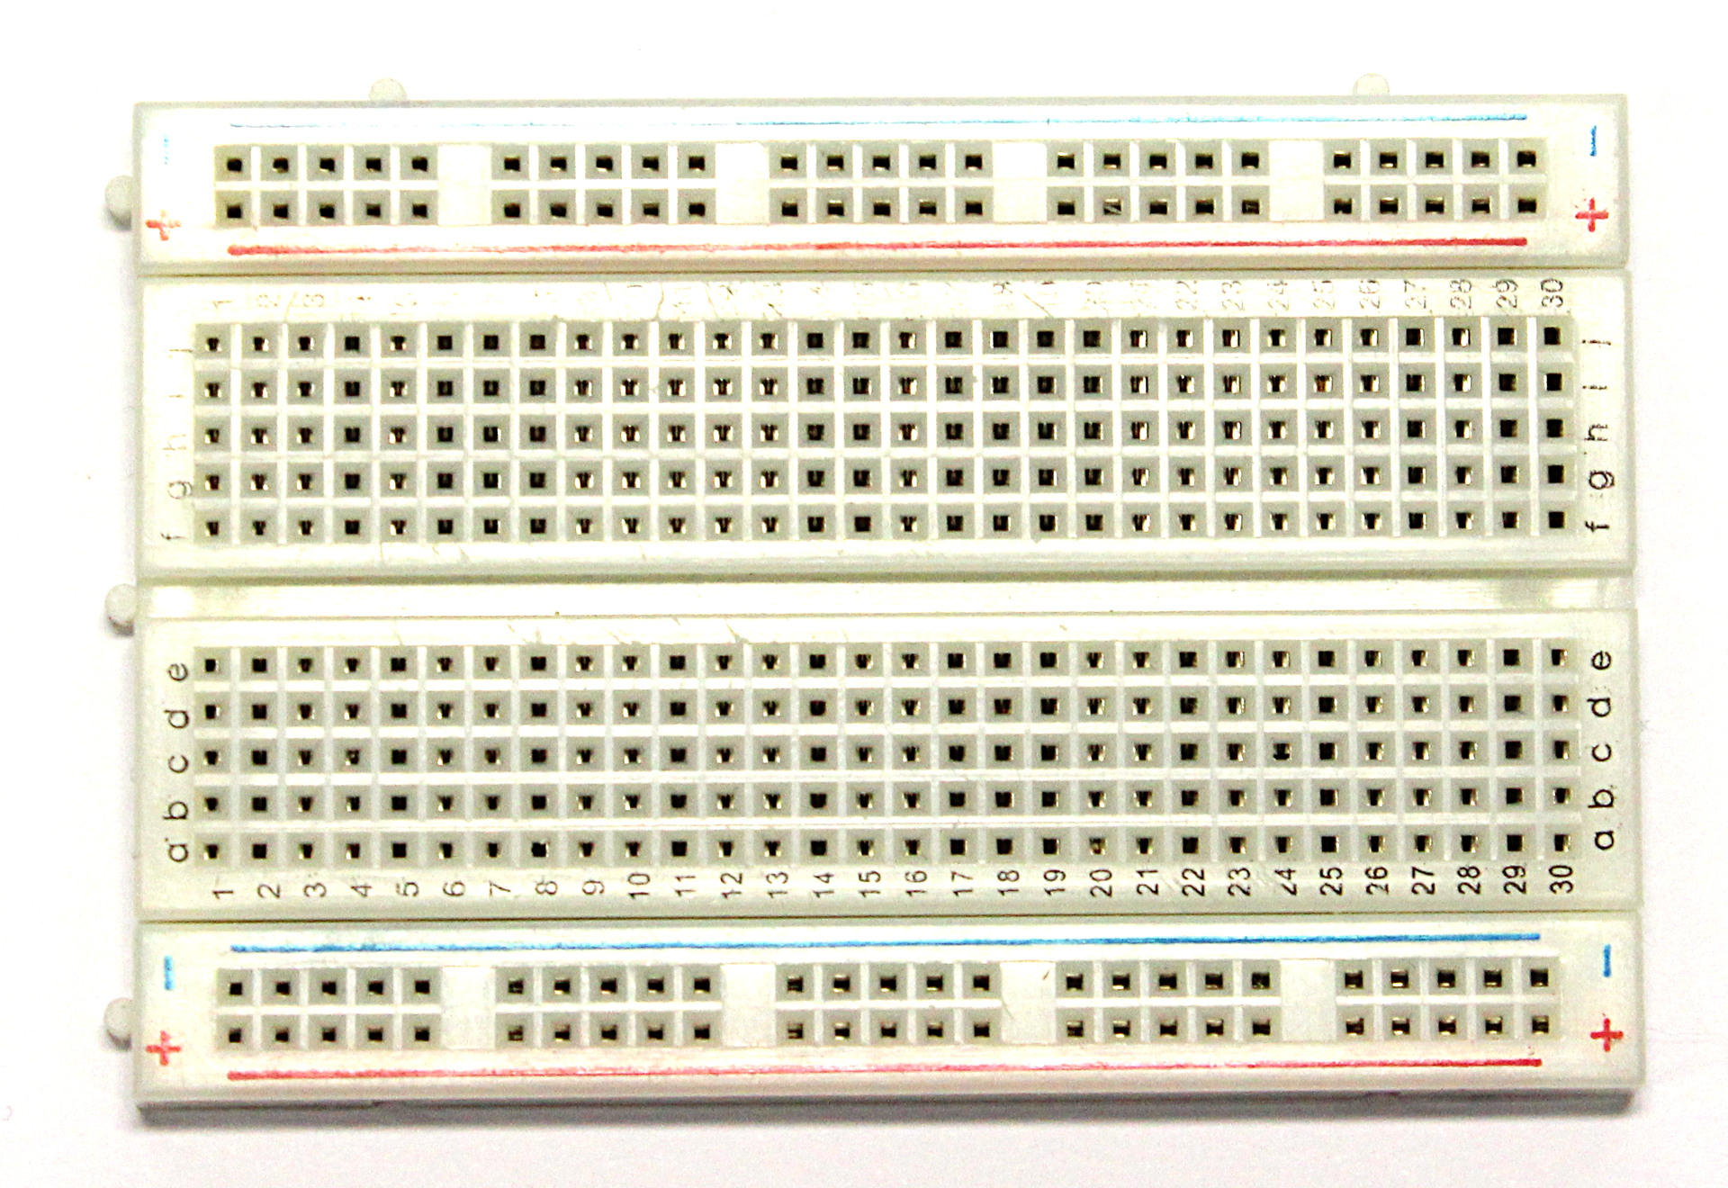
Breadboard

Slide 12
Tutorial 01 - Electronics

